Slide 1
Employee salary prediction
CAPSTONE PROJECT
Presented By:
Rashmi
USCS, Uttaranchal University
AICTE Student id :-STU682a40c6e9e4f1747599558

Slide 2
OUTLINE
Problem Statement
System Development Approach (Technology Used)
Algorithm & Deployment (Step by Step Procedure)
Result
Conclusion
Future Scope
References

Slide 3
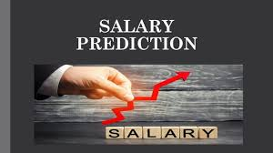
Problem Statement
Develop a machine learning model to predict whether an individual earns more than $50,000 per year using the adult csv dataset
The dataset includes various demographic and employment-related attributes such as age, education, occupation, and work class.
The goal is to analyze these factors and build a predictive model that can classify individuals into income categories (<=50K or >50K).
This classification task involves handling both categorical and numerical data, requiring appropriate preprocessing and feature engineering techniques.
Model performance will be evaluated using accuracy, precision, recall, and F1-score to ensure reliable and interpretable predictions.

Slide 4
System Approach
✅ System Requirements
Processor: Intel Core i5 or higher
RAM: Minimum 8 GB
Storage: At least 500 MB free disk space
Operating System: Windows 10 / Linux / macOS
Python Version: Python 3.7 or above
IDE/Notebook: Jupyter Notebook / VS Code / Google Colab
📚 System libraries
numpy – for numerical operations
pandas – for data loading and manipulation
matplotlib– for data visualization
scikit-learn (sklearn) – for:
Data preprocessing (LabelEncoder, )
Splitting datasets (train_test_split)
Building machine learning models(LogisticRegression, RandomForestClassifier)
Evaluating model
(accuracy_score, classification_report)

Slide 5
Algorithm & Deployment
1. Data Collection
Load the Adult Income Dataset using pandas.
Inspect the dataset using .head(), .info(), and .describe().
2. Data Preprocessing
Handle missing values and inconsistent data entries.
Convert categorical variables into numerical using encoders like LabelEncoder or OneHotEncoder.
Normalize or scale numerical features if necessary.
3. Exploratory Data Analysis (EDA)
Use matplotlib to visualize distributions, correlations, and outliers.
Analyse relationships between features and the target variable (salary).
4. Feature Selection
Identify and select the most relevant features that influence the target.
Drop redundant or irrelevant columns.
5. Splitting the Data
Split the dataset into training and testing sets using train_test_split.
6. Model Selection and Training
Choose suitable classification algorithms (e.g., Logistic Regression, Random Forest, SVM, etc.).
Train models using the training data.

Slide 6
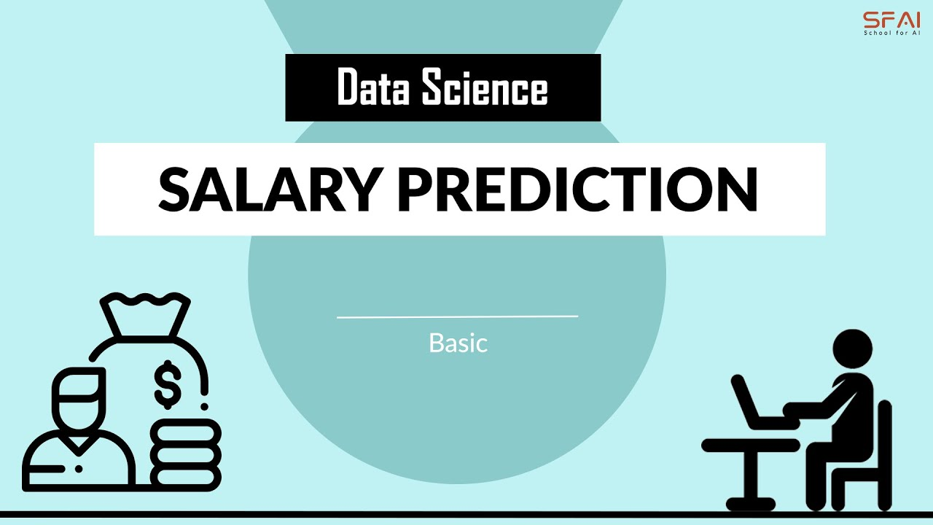
7. Model Evaluation
Evaluate model performance on the test data using metrics like:
Accuracy
Precision
8. Hyperparameter Tuning (Optional)
Use techniques like Grid Search or Randomized Search to improve model performance.
9. Model Saving (Optional)
Save the trained model using joblib or pickle for future use.
10. Deployment / Reporting
(Optional) Deploy the model or present results in a report/dashboard.

Slide 7
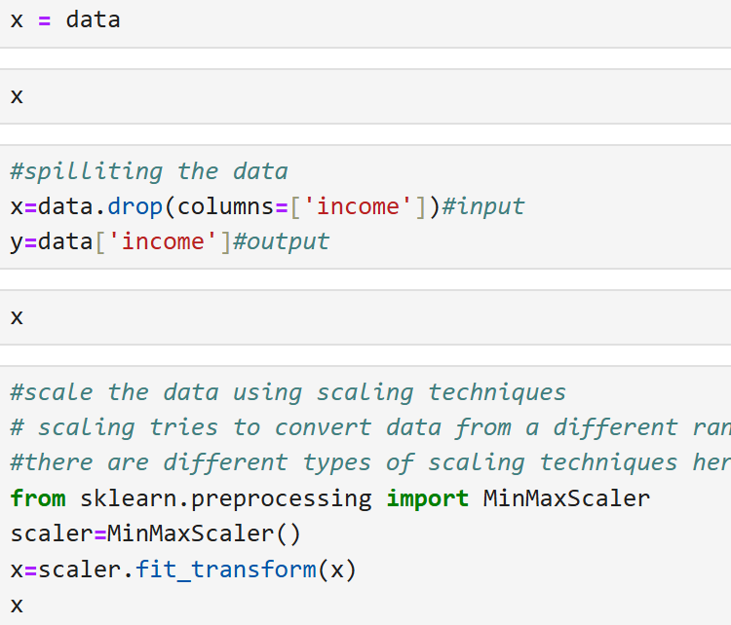
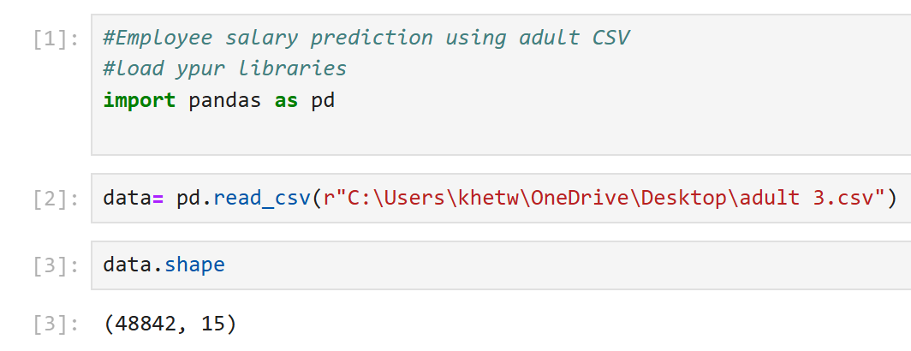
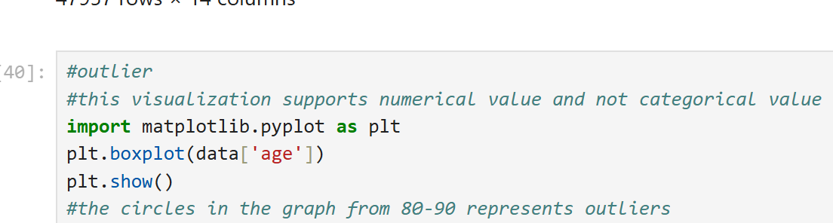
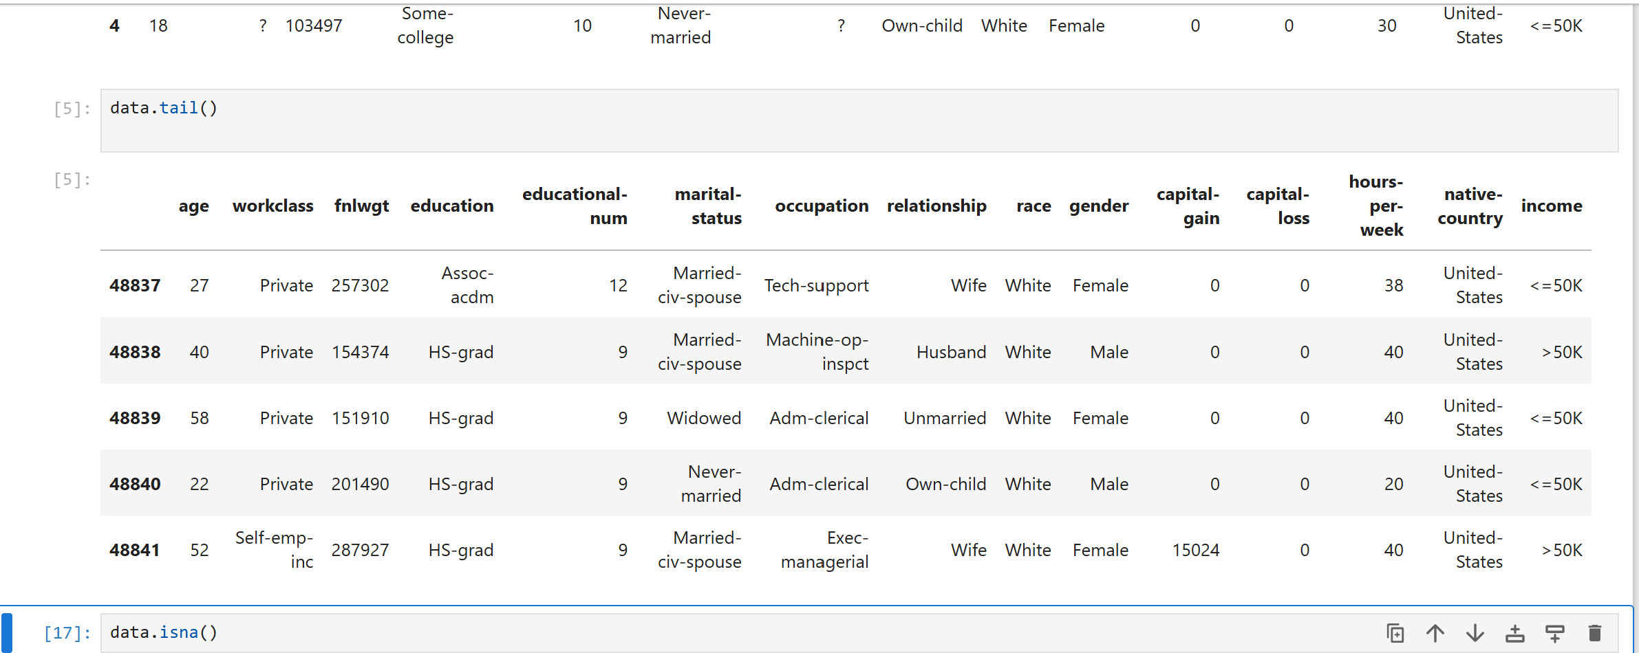
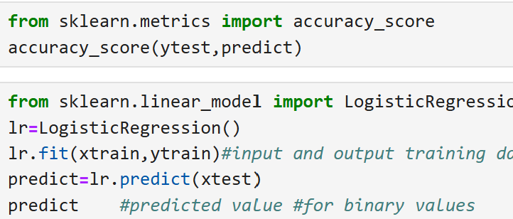
Result
Code:

Slide 8
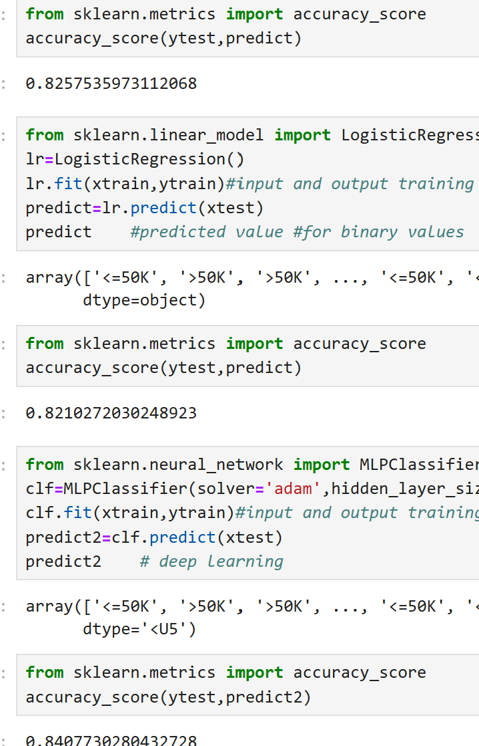
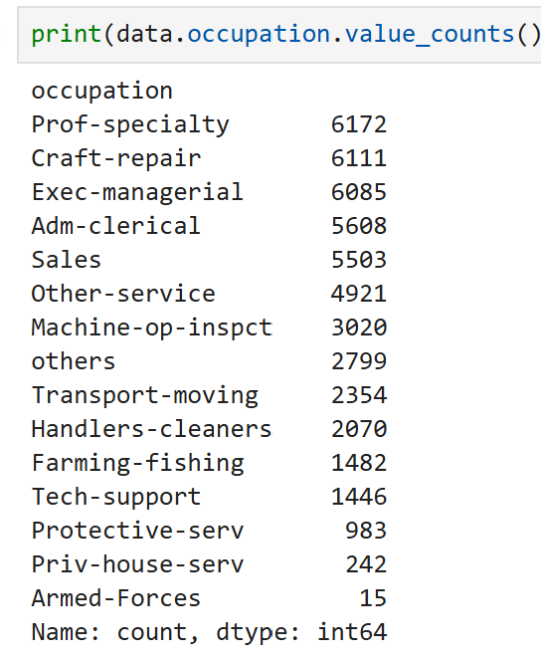
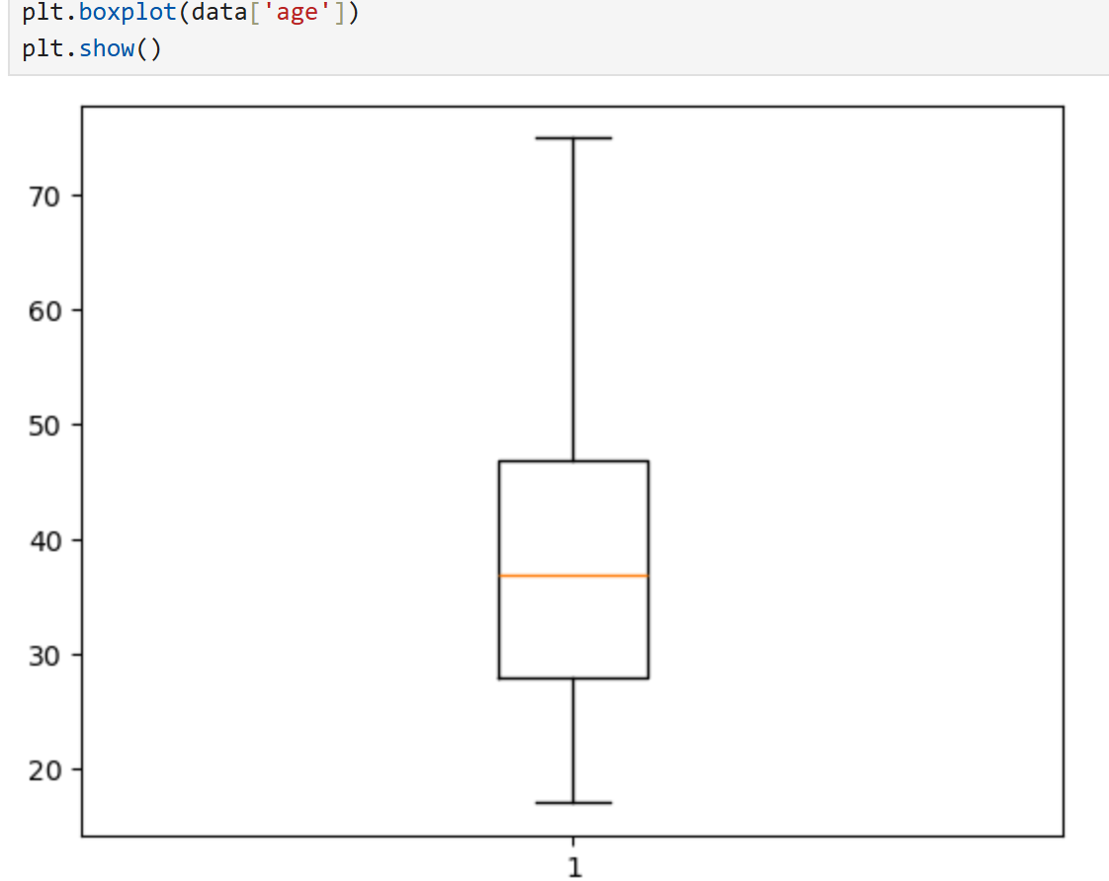
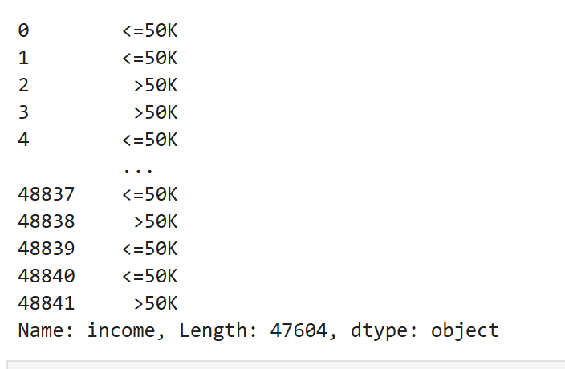
Result
Outputs:
Github:- https://github.com/RASHMI-khetwal/AICTE--EMPLOYEE-SALARY-PREDICTION.git

Slide 9
Conclusion
✅ Summary:-
• A machine learning model was developed to predict whether an individual earns more than $50K/year using the Adult Income Dataset.
• The dataset was preprocessed using encoding techniques to handle categorical variables.
• After training and testing the model, it achieved an accuracy of (insert your actual accuracy here, e.g., ~86.3%indicating good performance in classifying income levels.
⚠️ Challenges Faced:-
Managing missing or ambiguous values in categorical fields.
Avoiding SettingWithCopyWarning while modifying slices of the DataFrame.
Ensuring the correct split of training and testing data to avoid data leakage or class imbalance.
🔧 Potential Improvements:-
Experiment with more advanced models like Random Forest, XGBoost, or Gradient Boosting.
Improve preprocessing by handling outliers and exploring feature scaling.
Use cross-validation for more reliable performance estimation.
Incorporate a web interface or dashboard to make the model usable by non-technical users
💡 Effectiveness of the Proposed Solution:-
The model demonstrates good generalization and captures patterns across features like education, occupation, and marital status.
It serves as a practical baseline solution for income classification tasks in HR and social research.

Slide 10
Future scope(Optional)
Potential Enhancements and Expansions:-
Improve Model Performance: Use advanced algorithms like XGBoost or apply hyperparameter tuning for better accuracy.
Feature Engineering: Create new meaningful features and remove less important ones to enhance model efficiency.
Real-Time Deployment: Develop a simple web app using Flask or Streamlit for live predictions.
Better Visualization: Integrate interactive dashboards for easier interpretation of results.
Fairness & Explainability: Ensure the model is unbiased and use tools like SHAP to explain predictions.

Slide 11
References
• UCI Machine Learning Repository – Adult Dataset Source of the dataset used in this project. https://archive.ics.uci.edu/ml/datasets/adult
• Scikit-learn Documentation Used for model building, data preprocessing, and evaluation metrics. https://scikit-learn.org/stable/documentation.html
• Pandas Documentation For data manipulation and analysis. https://pandas.pydata.org/docs/
• Matplotlib Documentation For data visualization during EDA. https://seaborn.pydata.org/ https://matplotlib.org/

Slide 12
THANK YOU

